Slide 1
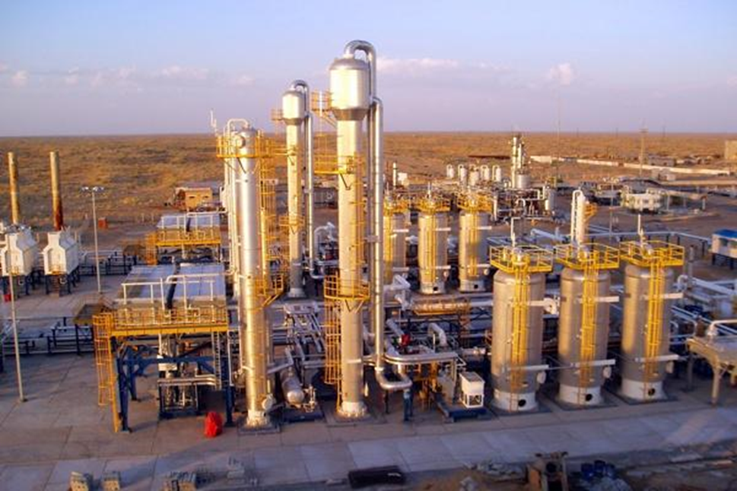
Electrical Equipment in Hazardous Industries
Madhumita Sanjay Patil
2091BEE17
3rd year

Slide 2
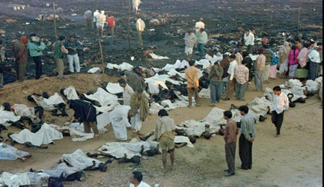
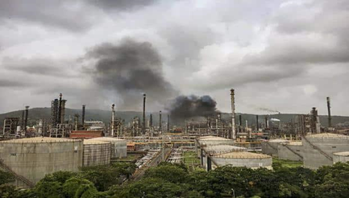
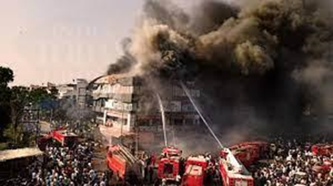
Some more fire incidents
DAV school, Haryana
Petroleum corporation, Mumbai
Commercial complex, Surat
500 died including 253 children
40 people Injured
22 students died

Slide 3
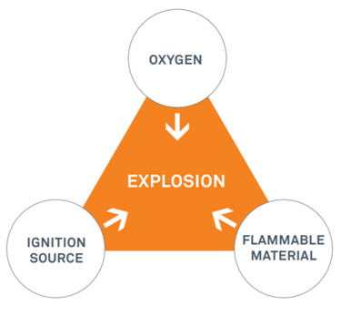
Introduction
Many fire accidents have happened in hazardous industries in the past and many have lost their lives in such incidents. In some hazardous industries, it has led to catastrophic disasters. If we go through the investigation of such incidents the electrical spark is one of the root causes for such incidents.
As a rule, for explosions to happen in atmospheric air, three factors have to be present at the same time
flammable material
oxygen (air)
source of ignition

Slide 4
Analysis
Hazardous area
Explosive atmosphere
Primary explosion protection
Secondary explosion protection
Hazardous area classification
Class/Division system
Zonal system
Groups
NEC enclosure classification
ATEX enclosure classification

Slide 5
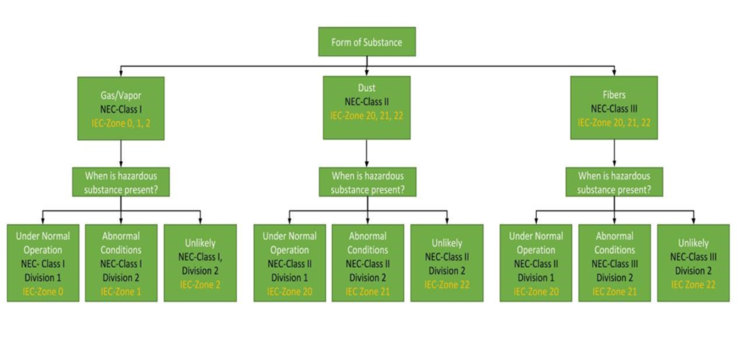
Hazardous area classification
CEO

Slide 6
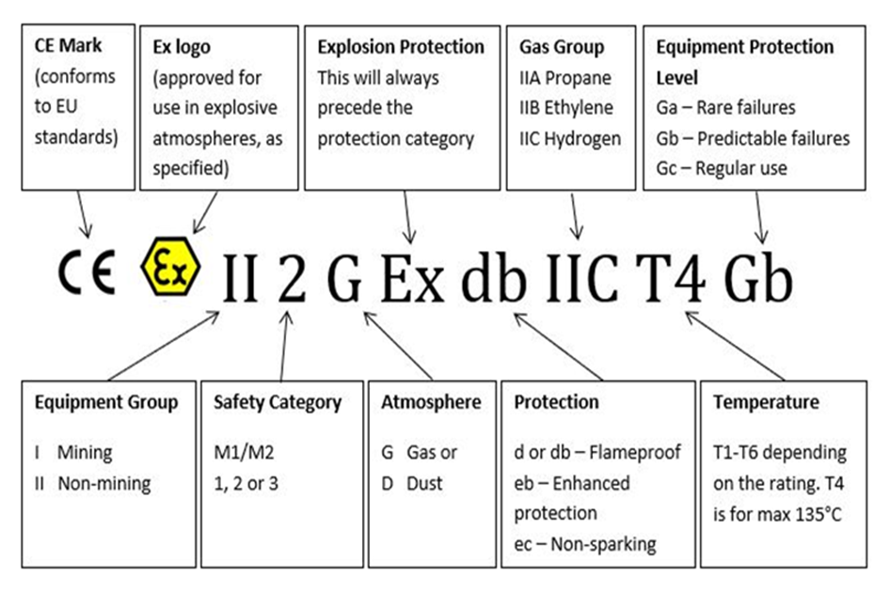

Slide 7
Conclusion
While selecting the electrical equipment for the hazardous area we need to make sure that we select the standardised approved equipment for the particular area. For selecting correct equipment one should know the exact class, division , group, temperature and atmosphere where the equipment has to be installed. Selection must be done only after the proper study of all the guidelines and the standardised codes because one small mistake can lead to a big disaster.

